Slide 1
Planning Commission 2024

Slide 2
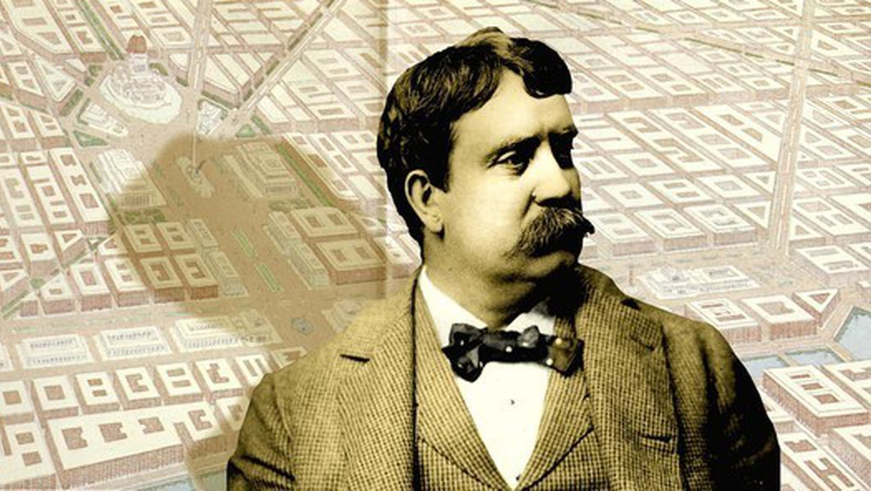
Let your watchword be order and your beacon beauty.
Notes:
Daniel Burnham
Father of American Planning
Father of the Skyscraper
Architect
World’s Fair 1893, Chicago

Slide 3
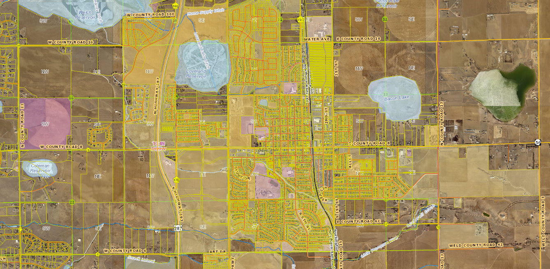
Why do we plan?

Slide 4
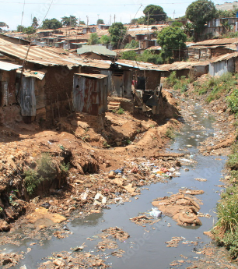

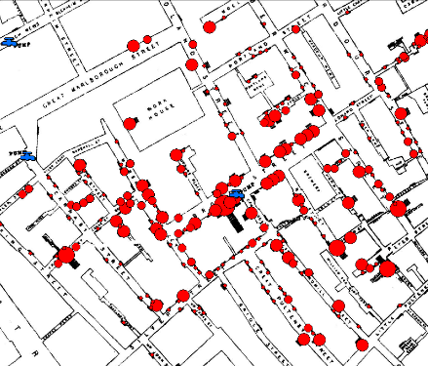

Notes:
These are extreme examples
Kibera, Nairobi – no infrastructure, no social services, no sanitary landfill, no paved streets, no building codes
Sign over-proliferation
1855 map – John Snow’s cholera map, London
We plan to provide for efficient services, a healthy and pleasing environment for all

Slide 5
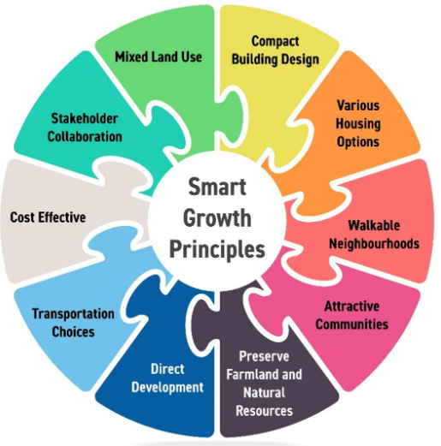
We plan for efficiency
Sustainable growth
Infrastructure & Service
Enhance & protect the natural
and built environments
Disaster mitigation
Economic resiliency
Balance public-private interests
Encourage citizen engagement
Improve the quality of life for residents
Housing
Safety
Amenities
Job opportunities
Notes:
We plan to make good decisions
As communities continue to grow, so do challenges and complex issues
Requires forward thinking

Slide 6

Berthoud Planning Toolbox/eNotebook
Ordinance 1241
Land Use Code & Zoning Map
Comprehensive Plan & Future Land Use Map
Master Plans
Innovation District
3rd Street
Mountain Avenue
Open Space
Transportation
Trails
Cooperative Planning Agreements
Chairperson’s meeting script
Planning Tool Kit

Slide 7



Criteria for Approval: Use by Special Review Permit 30-3-106.C
Criteria for Approval, aka Swim Lanes
Conditional Use review criteria. The Town may approve a conditional use application if it finds that each of the following criteria are satisfied:
Meets applicable provisions of the zoning code & subdivision regulations.
Conforms with the goals, policies and strategies in the Comprehensive Plan.
Adequate service and facilities without undue burden.
Does not alter the [zoning] district character.
Includes provisions for efficient on- and off-site traffic circulation.
Potential negative impacts have been mitigated.
All applicable local, state and federal permits have been or will be obtained.
Notes:
Example SUP - We all need them – they keep us focused and out of trouble. Tami and Sam will discuss this further.
Staff’s role is to evaluate the application, review referral agency comments and incorporate as necessary, consider public comments received prior to the hearing. Staff’s report reflects the LUC, Comp Plan and other Master Plans.
Not subjective, must be code-based
Staff’s report will contain an analysis on how these have been met, the record will state that these have been met

Slide 8




Land Use Planning Process
1. PRE-APPLICATION
PUBLIC MEETING /
HEARING
Discussion with Staff
Pre-Application conference (TRC)
Staff input and direction
Application preparation
Staff presentation
Applicant’s presentation
Public hearing
Discussion and vote
APPLICATION
SUBMITTAL
POST-APPROVAL
ACTIONS
Application materials received
Completeness review performed
Public notification and comments
Referral notification and comments
Staff review and comments
Resubmittals and reviews
Schedule and notice public meetings/hearings
Conditions of approval
Signing documents
Recording documents
Records management

Slide 9




Public Hearing Information Guide
1. STAFF PRESENTATION
The agenda item is introduced by Town Staff, including details of the official request, location, and how the project satisfies the Development Code and Comprehensive Plan
DISCUSSION
& VOTE
2. APPLICANT PRESENTATION
The applicant presents their proposal and makes their case for approval.
The Trustees/Commissioners confer and have an opportunity to ask the applicant or staff questions that arose during the public hearing period or questions of their own.
A motion must be made on an item, and if a motion is seconded, a vote is called; a majority must be found for any issue to pass (tie votes do not result in the passage of the item).
If any citizen disagrees with the decision, they have 30 days to file an appeal with the Town.
3. PUBLIC HEARING
The public hearing is opened for testimony.
One at a time, citizens have an opportunity to speak for up to 3 minutes about the proposed project. This time is used to ask questions, provide concerns, and offer approval or disproval of the proposal.
  Public comments are testimony. The Applicant, Staff and Trustees/Commissioners will not respond to the comments until all testimony has been received and the public hearing is closed.
Once all who wish to speak have done so, the Mayor / Chairperson will officially close the Public Hearing which ends the public testimony period.
Notes:
Walk through this cycle

